Slide 1

Catch-23
Candace Liu, Rilson Nascimento, Lei Pan, Usman Qazi, Andrew Sharo, Jordan Wilheim

Slide 2

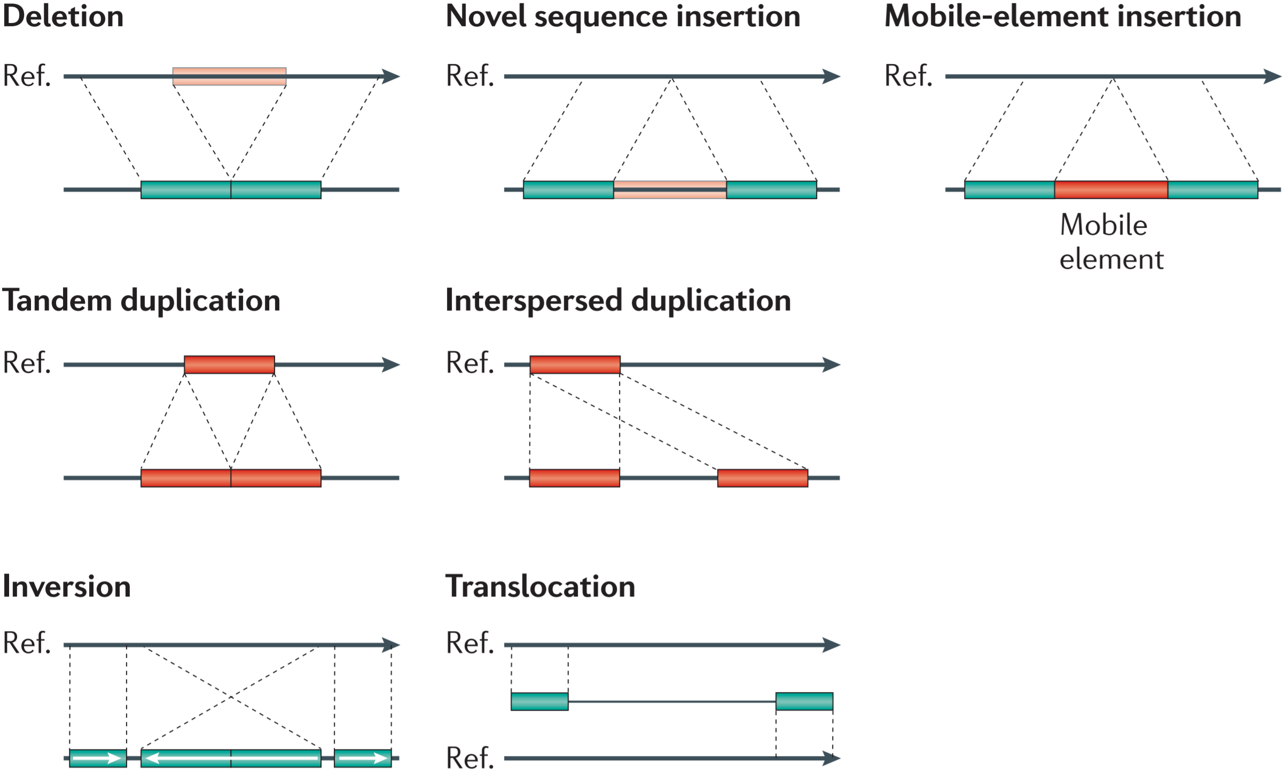



Challenge: filtering structural variants is limited by population databases
PASS
only
16,822
6,110
5,102
Less than
1,000,000 bp
exonic
3,795
3,243
188
5,021

Slide 3


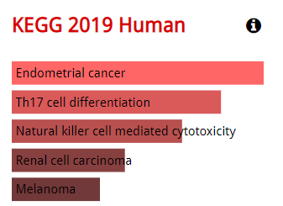
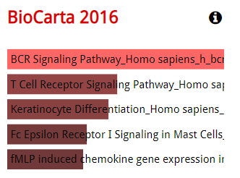
We explored immune variants which were previously identified
693 genes
Ensembl Variant Effect Predictor
MAF < 1%
134,936 variants
1,811 immune genes
WGS DeepVariant
High impact from VEP
High CADD, Condel, LoFtool
PDGFRL
Sequence similarity to ligand binding domain of platelet-derived growth factor receptor
Tumor suppressor?
IFIH1
Instructions for producing MDA5
Important role in innate immunity

Slide 4
We identified an intriguing SNV + SV in PDE4DIP by combining approaches
dbscSNV = 0.886
absent from gnomAD
-4 exon het deletion
-Exons 18-21
-Absent from gnomAD SVs
-Predicted by StrVCTURE to be deleterious (0.92)
AG|AC
exon 13
splice acceptor site

Slide 5
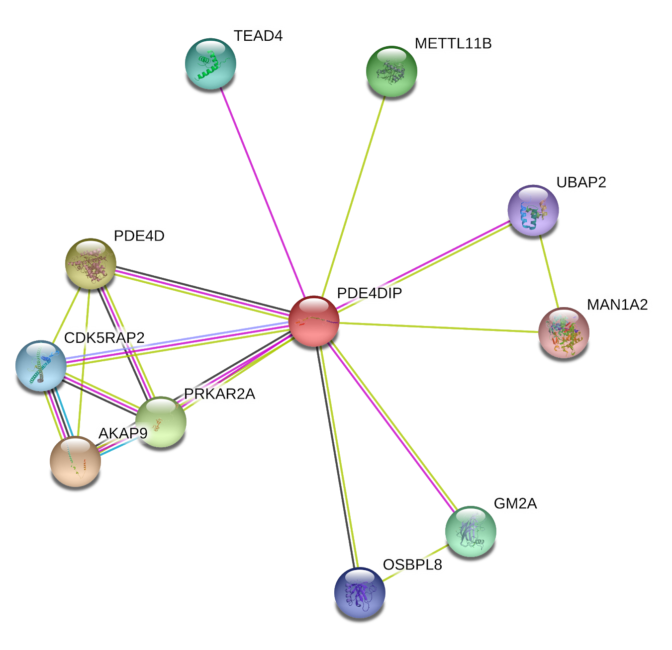
PDE4DIP (myomegalin) is important for
cell movement
Anchor protein on the Golgi/centrosome
Important for microtubule assembly and cell movement
Defects may cause myeloproliferative disorder (MBD) associated with eosinophilia
Eosinophils are important for fighting multicellular parasites
Associated with allergy and asthma

Slide 6
Transcriptomic and parental data will be used to confirm our findings
Combine with transcriptomic data
How do these variants affect gene expression?
How are they manifested at the phenotype level? For example, missing receptors on immune cells, different proportions of cells in circulation?
Better understand the link between genotype and phenotype
Genotypes from parents
Phasing to confirm compound heterozygote
De Novo structural variants and single nucleotide variants

